Slide 1
Bringing on new people (but probably not CINful ones)
Fall Group Meeting 2 10/16/2015

Slide 2
New Hires!
Officially hired two students, and they accepted!
  Boyang Zhao (MRD), Alvin Shi (Price’s Theorem)
Getting set up with Randstad now/putting in laptop requests etc.

Slide 3
CIN Project Updates
From last time: SKY data from Compton lab could show obligate tetraploid state
  Fitness landscape flat at >> 2N
  Fitness barrier close to 2N
Questions:
  What about multiple-chromosome missegregation events?
  Is bimodal distribution accurate?

Slide 4
Sanity Check – ‘No weirdness’ Assumption?
1 chromosome missegregation every 1-5 cell divisions
  Thompson and Compton 2008 http://www.ncbi.nlm.nih.gov/pmc/articles/PMC2265570/
Multiple chromosome events relatively rare (Marianna)
Looking for more supporting references!
  Continuous vs. discrete

Slide 5
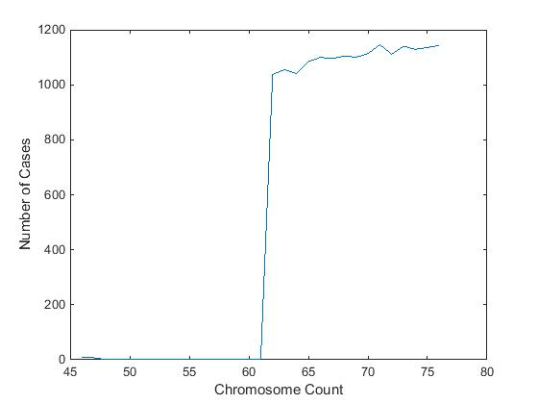
Double-checking bimodal distribution

